Slide 1

Azure Administrator AZ-104 (COURSE-END PROJECT)
ASHUTOSH SRIVASTAVA
12ASHU12@GMAIL.COM
WWW.LINKEDIN.COM/IN/ASHUTOSH-SRIVASTAVA-12ASHU12

Slide 2
PROBLEM STATEMENT AND MOTIVATION
Description: The Rand Enterprises Corporation is evaluating Azure as a deployment platform. To help the company with its evaluation, you need to create virtual networks in the region specified by Rand Enterprises Corporation. You have to create test virtual machines in two virtual networks, establish connectivity between the two networks via VNet peering, and ensure connectivity is established properly.
To test the platform, Rand Enterprises Corporation wants to onboard an employee on the company’s default Azure Active Directory and assign a Custom RBAC role, under which they will be able to read the network and storage along with the VM. Under this custom RBAC, the employee should also be given permission to start and restart the VM. You have to onboard the employee under the default Azure AD and create a custom RBAC for the role of computer operator for this employee.
As a security measure, you need to ensure that the onboarded user can only access the resources mentioned in the custom role and adhere to the principle of least privi

Slide 3
Project Objectives
Create virtual networks in the specified Azure region.
Deploy test virtual machines (VMs) in two virtual networks.
Establish VNet peering for connectivity between the networks.
Onboard an employee to Azure Active Directory (AD).
Create and assign a custom RBAC role for the employee.

Slide 4
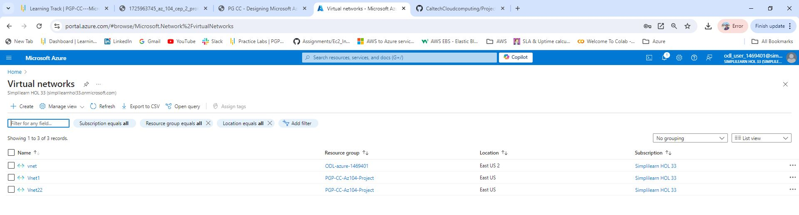
Step 1 - Create Virtual Networks
1. Log in to Azure Portal: Access the Azure portal using your credentials.
2. Create Virtual Networks:
- Navigate to Create a resource > Networking > Virtual Network.
- Specify the name, address space, and region for the first virtual network (e.g., VNet1).
- Repeat the process for the second virtual network (e.g., VNet2).

Slide 5
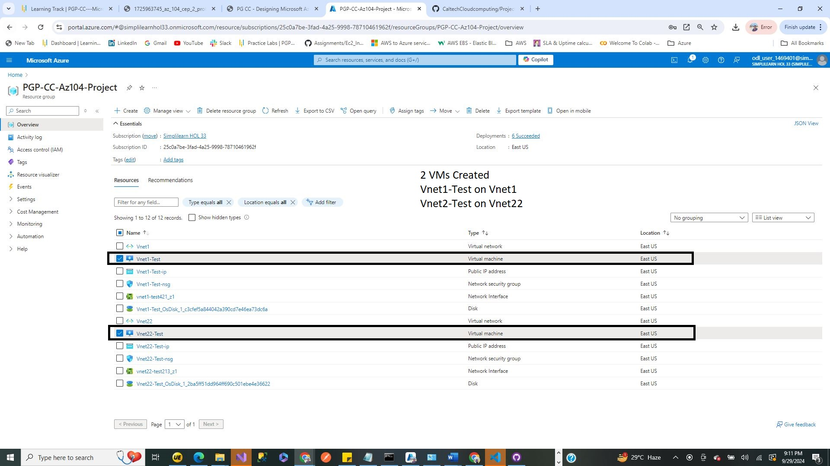
Step 2 - Create Test Virtual Machines
1. Create Virtual Machines:
- Navigate to Create a resource > Compute > Virtual Machine.
- Select the appropriate virtual network (VNet1) and configure the VM settings (size, OS, etc.).
- Repeat the process to create a VM in the second virtual network (VNet2).

Slide 6
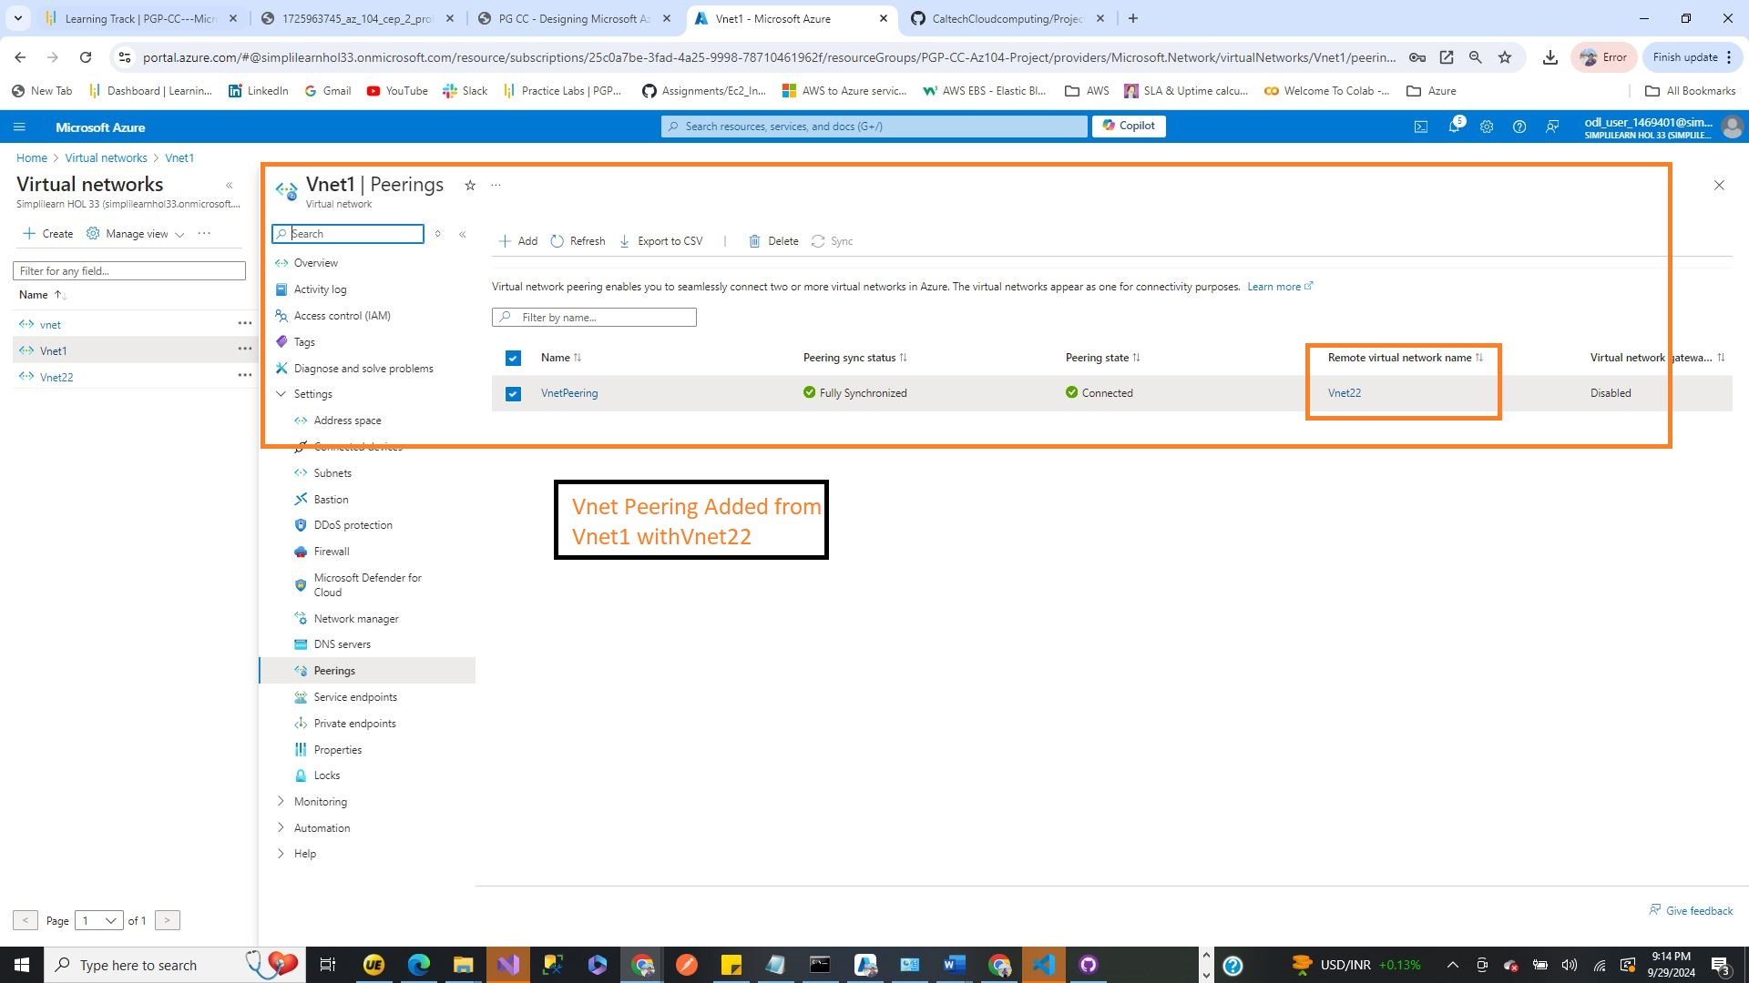
Step 3 - Establish VNet Peering
1. Navigate to VNet Peering:
- Go to the first virtual network (VNet1).
- Under Settings, select Peerings > Add.
2. Configure Peering:
- Name the peering connection and select the second virtual network (VNet2).
- Enable Allow virtual network access and configure any additional settings as needed.
- Repeat the process from VNet2 to VNet1 to establish bi-directional peering.

Slide 7
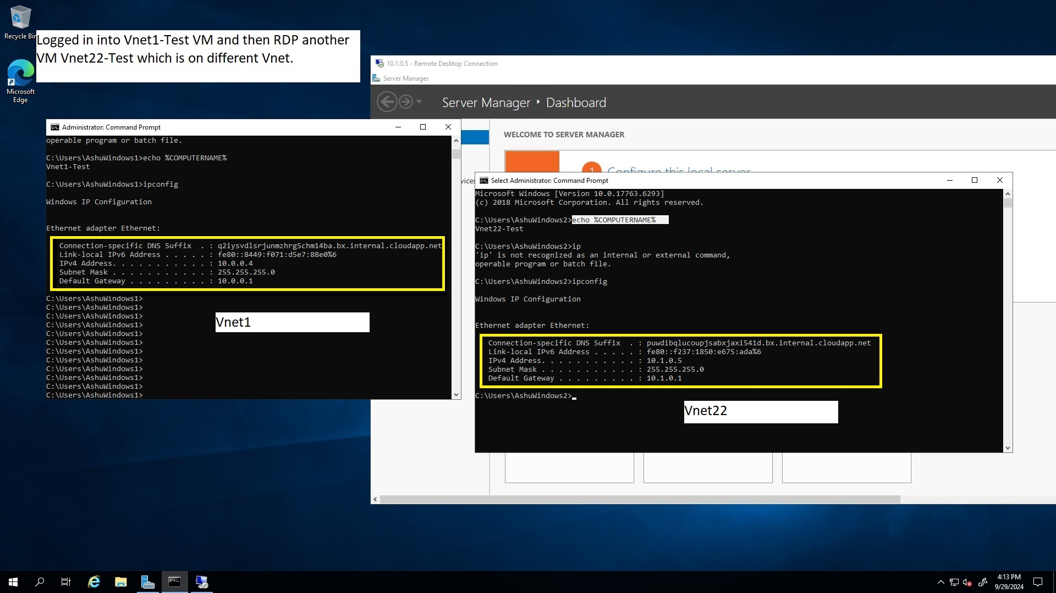
Step 4 - Verify Connectivity
1. Test Connectivity:
Logging into first VM on Vnet1.
Now using Private IP address on Another VM which is on different Vnet Vnet22.
- Verify that both VMs can access shared resources.

Slide 8
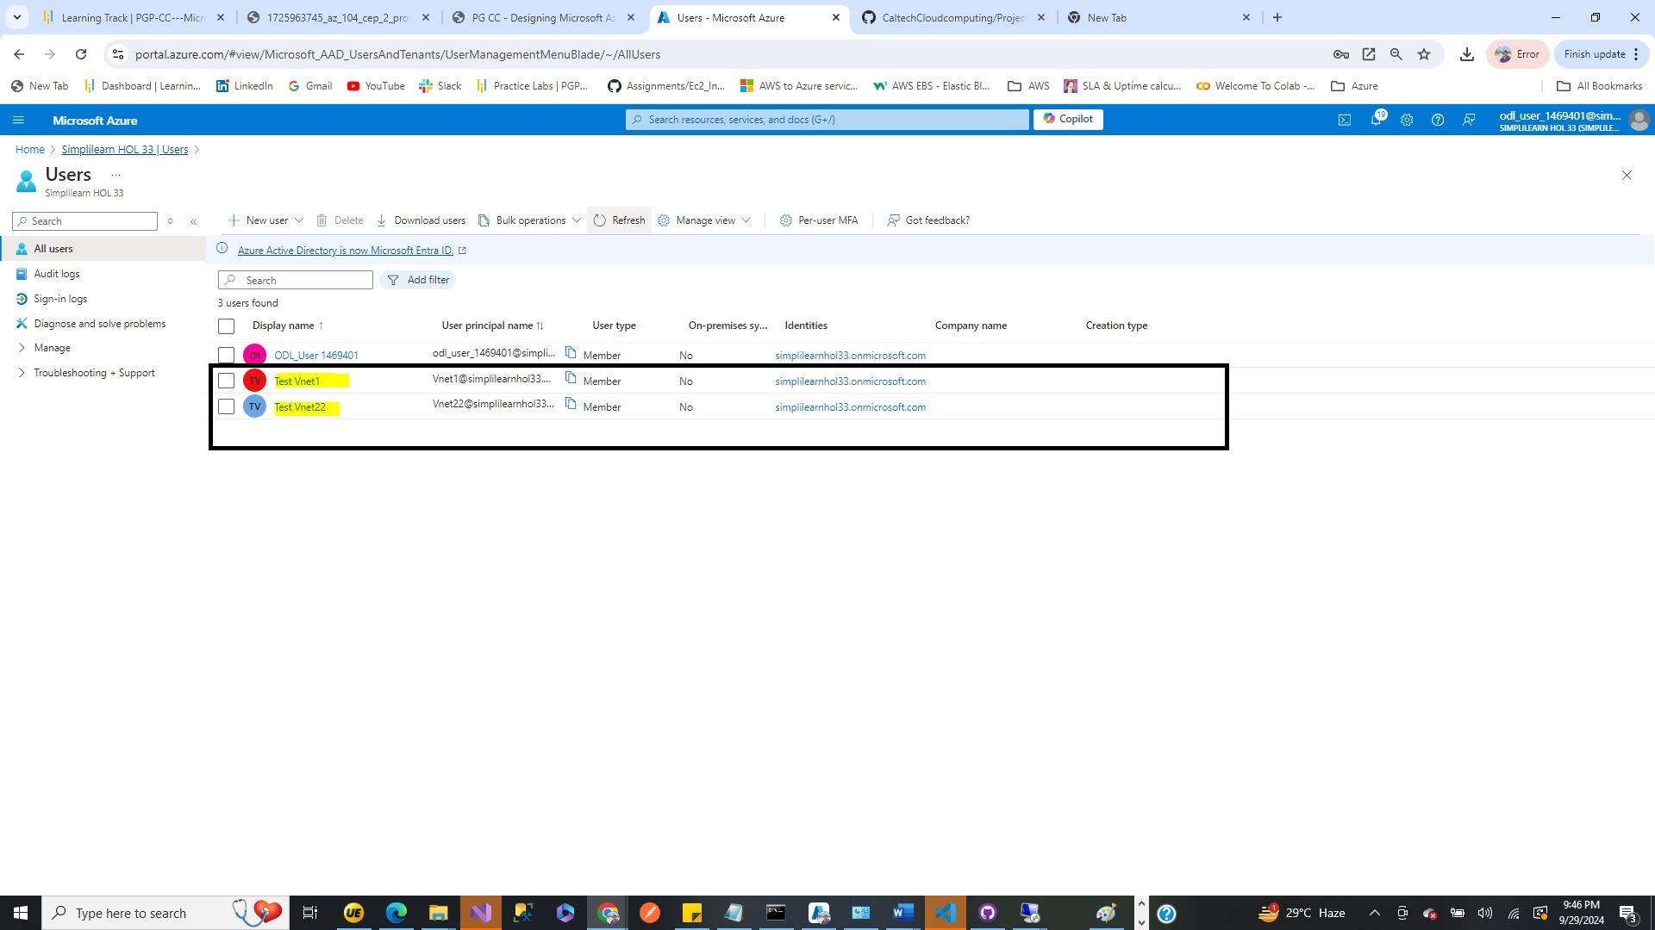
Step 5 - Onboard Employee to Azure AD (Microsoft Entra ID)
1. Navigate to Azure Active Microsoft Entra ID :
- Go to Azure Microsoft Entra ID > Users > New User.
2. Create User:
- Fill in the required details for the new employee and assign them a username.

Slide 9
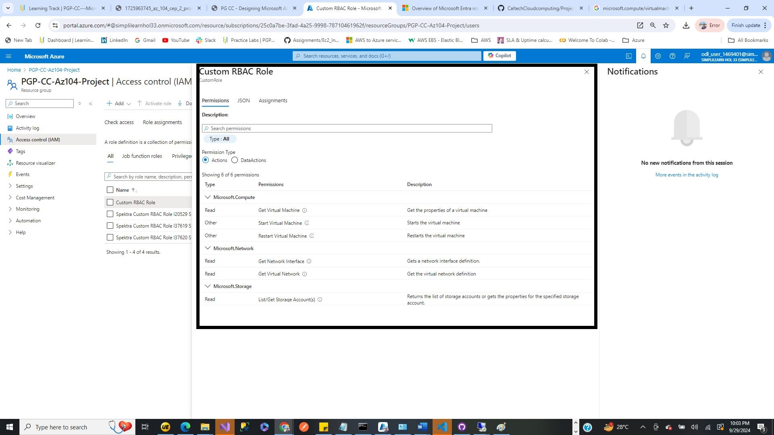
Step 6 - Create Custom RBAC Role
1. Define Custom Role:
- Navigate to Azure Active Directory > Roles and administrators > + Add custom role.
- Specify the role name (e.g., Computer Operator) and description.
2. Assign Permissions:
- Add permissions for reading network and storage resources, as well as starting and restarting VMs.
- Ensure adherence to the principle of least privilege by limiting permissions.

Slide 10
Step 6 - Create Custom RBAC Role
1. Define Custom Role:
- Navigate to Azure Active Directory > Roles and administrators > + Add custom role.
- Specify the role name (e.g., Computer Operator) and description.
2. Assign Permissions:
- Add permissions for reading network and storage resources, as well as starting and restarting VMs.
- Ensure adherence to the principle of least privilege by limiting permissions.

Slide 11
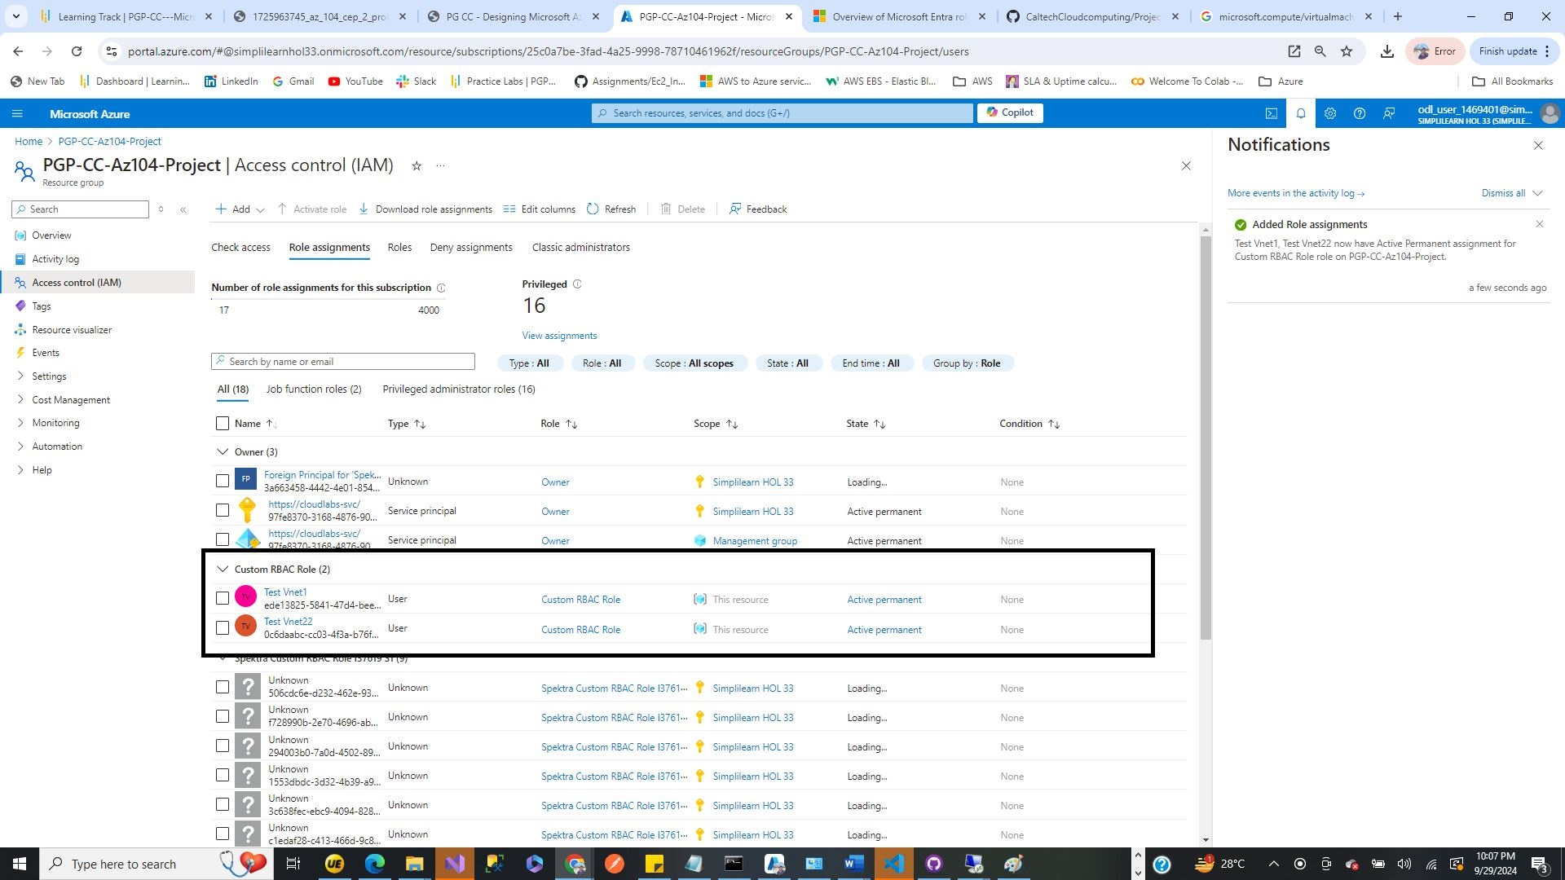
Step 7 - Assign Custom Role to Employee
1. Assign Role:
- Go to the resource group or specific resources where the role should be assigned.
- Select Access control (IAM) > Add role assignment.
- Choose the custom role and assign it to the newly onboarded employee.

Slide 12
CONCLUSION
Summary of the steps taken to connect Internet workloads using VNet peering and assign a custom role.
Emphasis on the importance of security and proper access management in cloud environments.

Slide 13


Thank You
12ASHU12@GMAIL.COM
WWW.LINKEDIN.COM/IN/ASHUTOSH-SRIVASTAVA-12ASHU12

